Slide 1

UNIMATE
Presentation
Moktar SELLAMI
2/18/2023
IEEE Robotics and Automation Society Chapter ISIMa Student Branch

Slide 2
Welcome

Slide 3
Work plan
Introduction to robotics
Definition of robotics
What is the composition of a robot
History and Evolution
Examples
Difference between software & hardware
Hardware
Software
What is an Embedded system
Introduction to Arduino & Arduino IDE
Introduction to Arduino and History
Arduino boards
Arduino Ecosystem
Example of Arduino projects
Downloading Arduino IDE & Building an application
Downloading Arduino IDE
A tour of Arduino IDE
The first program (Hello world): Blinking an LED
Arduino functions
Building Arduino Applications (Weather monitoring, distance measuring)
Replicating a robot:
Controlling a Robot Car via a Joystick controller (Radio Frequency)
Questions (20 min)

Slide 4
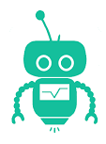
Introduction to robotics

Slide 5
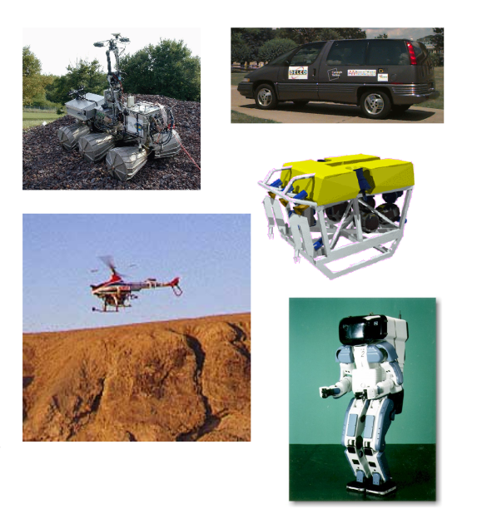
1. Definition of Robotics
A robot is a programmable machine that replicate or substitute for human actions.
The term Robotics describes the field of study focused on developing robots and automation.

Slide 6
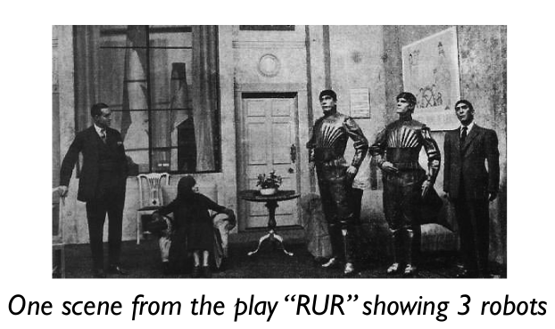
2. History
The first time the word “Robot” was used, was in a science fiction play in the Czech language created in 1920 by Karel Čapek. It was translated in English as “Rossum's Universal Robots”.

Slide 7
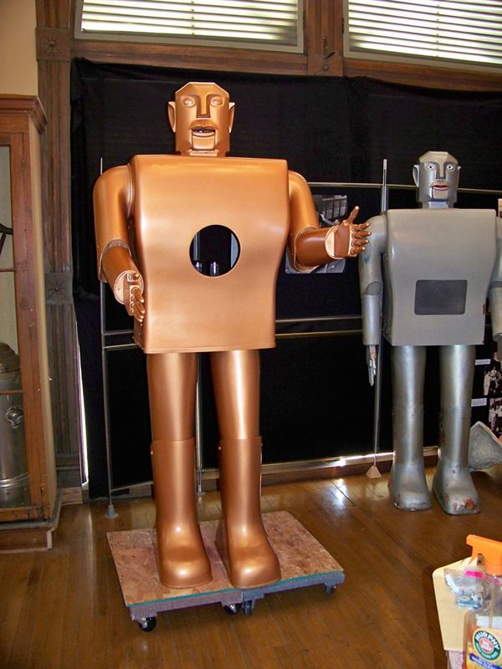
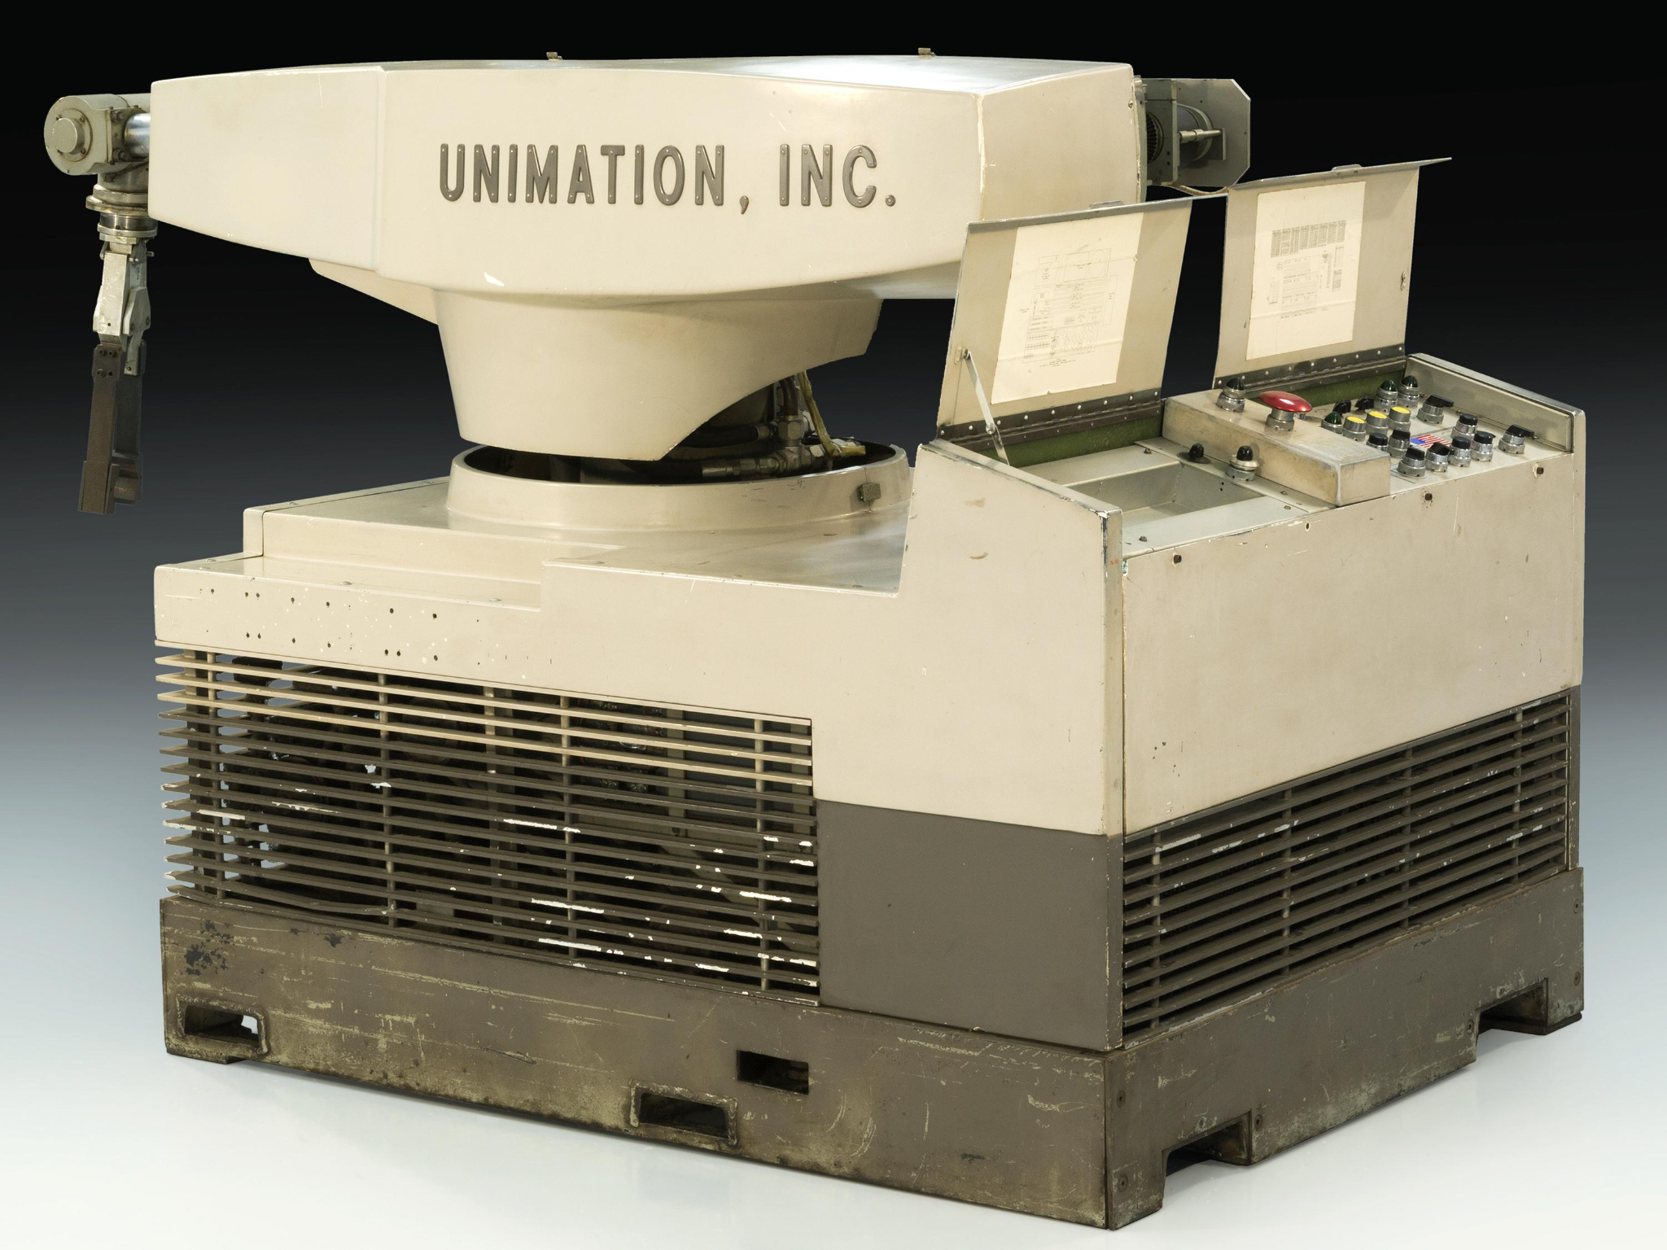
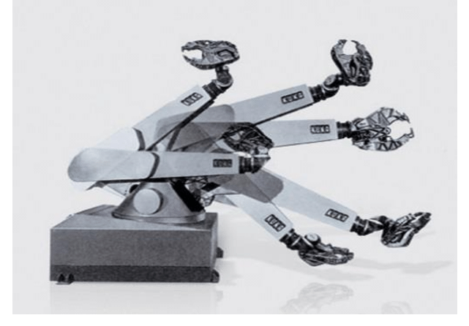
2. History
1939 : “Elektro”, humanoid robot presented at the world fair in NewYork from the Westinghouse Electric Corporation.
1956 : “Unimate”, first commercial industrial manipulator from the Unimation Company. It was first installed in 1961 in a General Motors plant.
1973 : “Famulus”, first 6 axis industrial robot from KUKA robotics.

Slide 8
2. The composition of a robot
Sensor
Actuator
Micro-controller

Slide 9
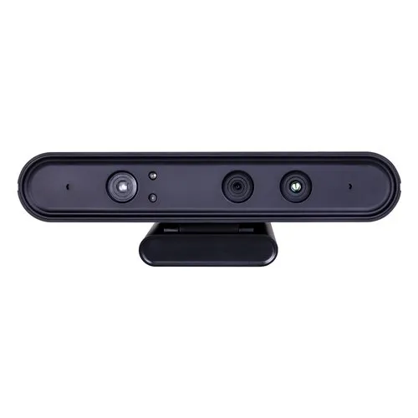
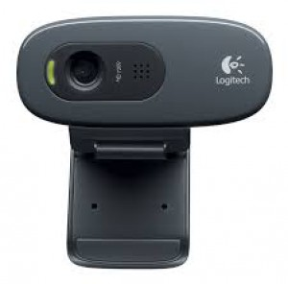
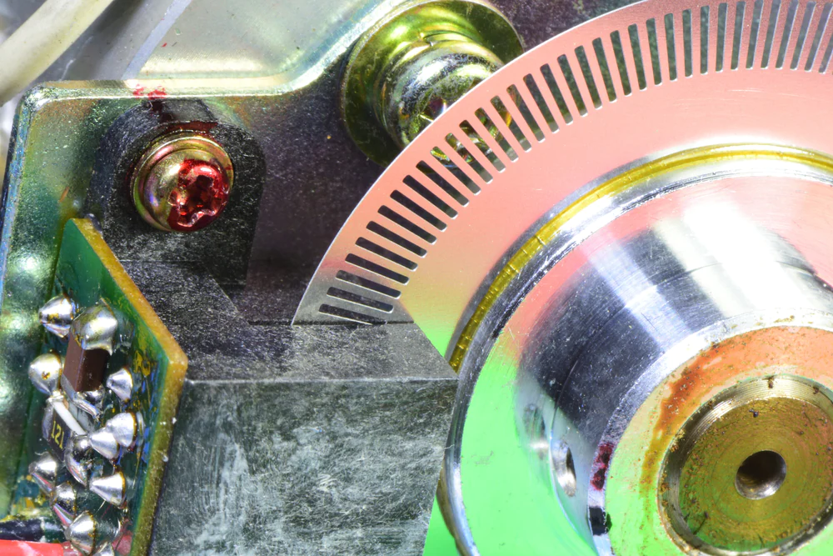
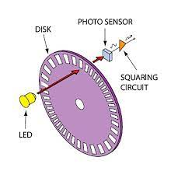
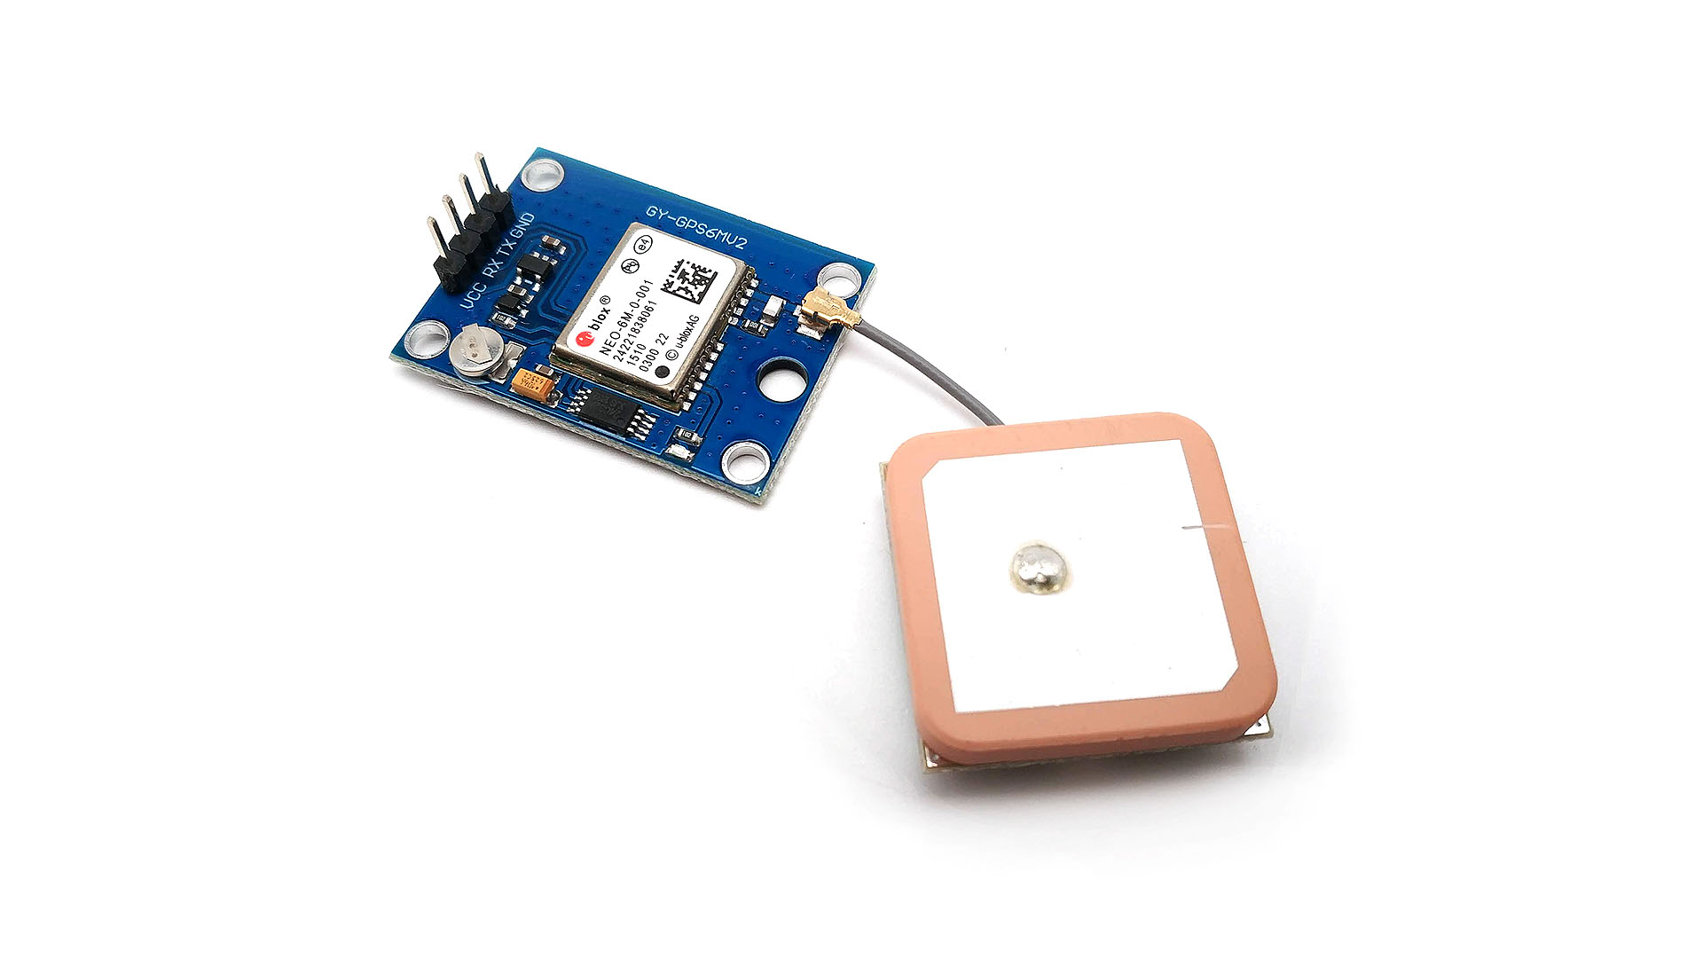
2. The composition of a robot
Sensor
Camera
Depth-sensor
Buttons
Encoders
GPS

Slide 10
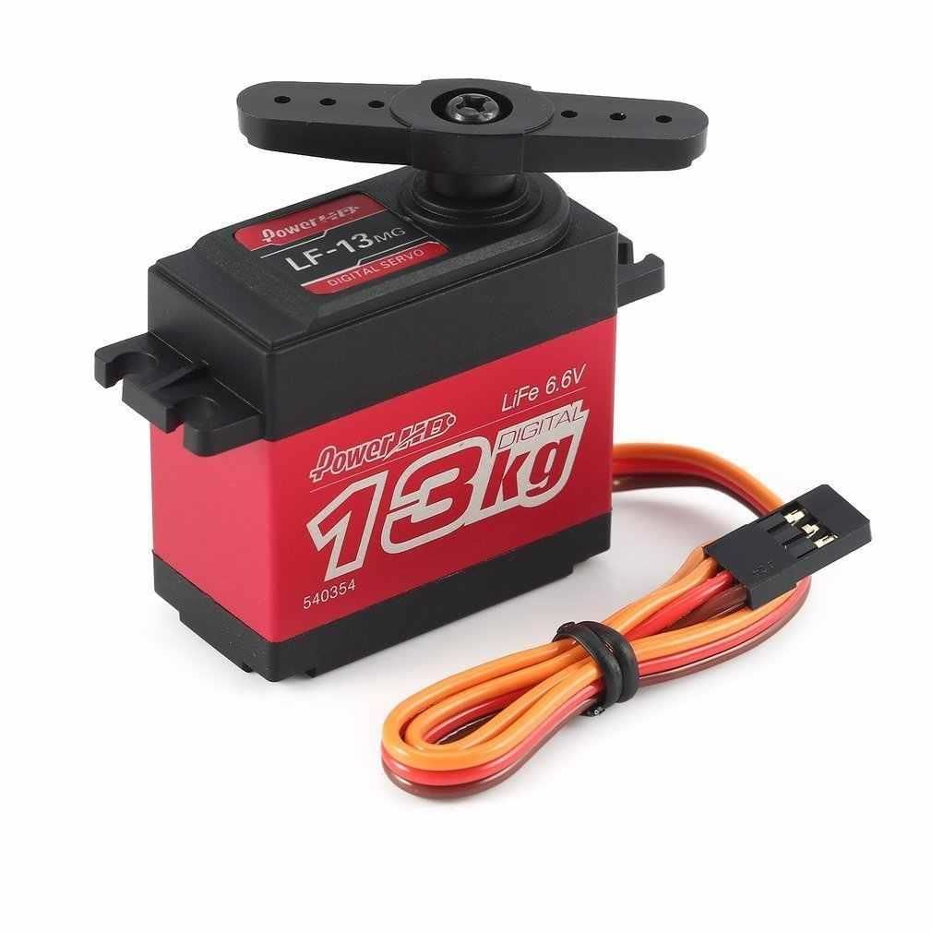
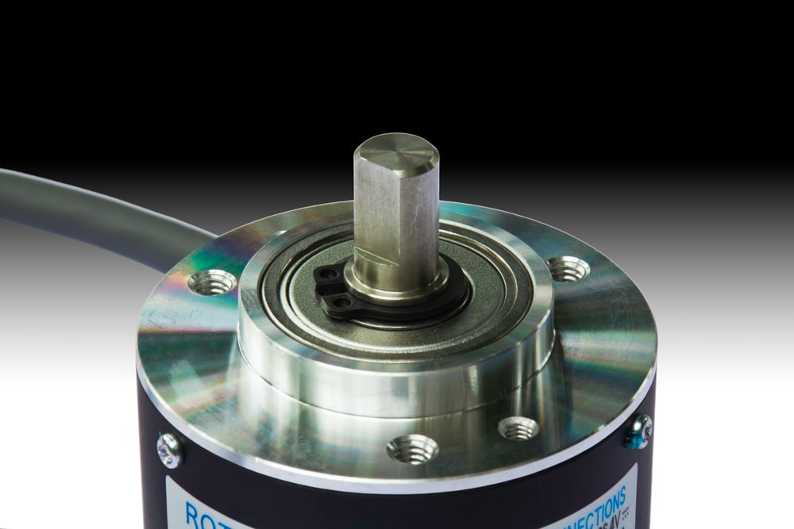
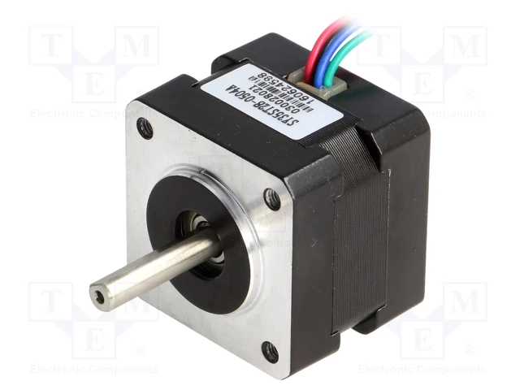
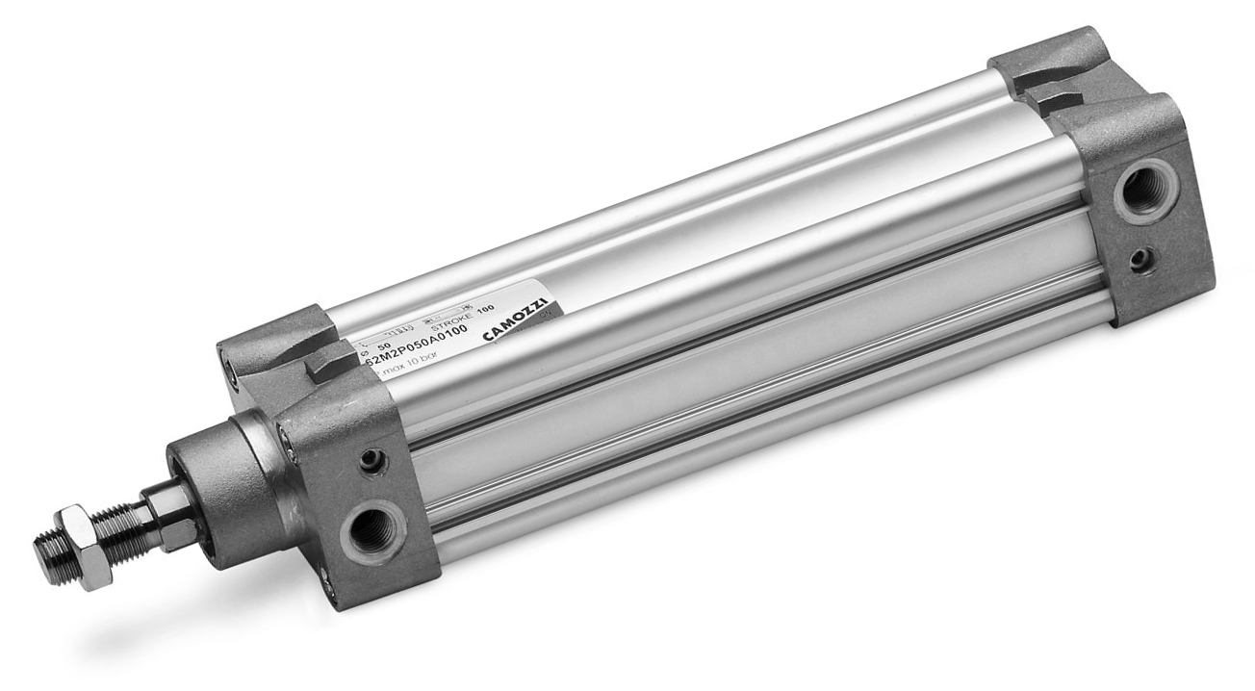
2. The composition of a robot
Actuator
Motor
Servo-motor
Stepper-motor
Hydraulic-press

Slide 11





2. The composition of a robot
Micro-controller
Raspberry PI
Arduino
Espressif
Texas-instrument
STMicroelctronics

Slide 12
Robot example projects

Slide 13
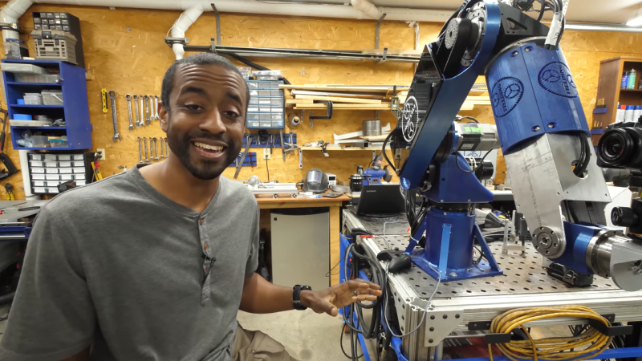
Building a Robot Arm
https://www.youtube.com/@JeremyFieldingSr

Slide 14
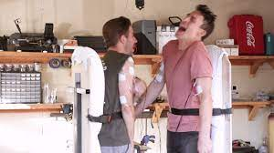
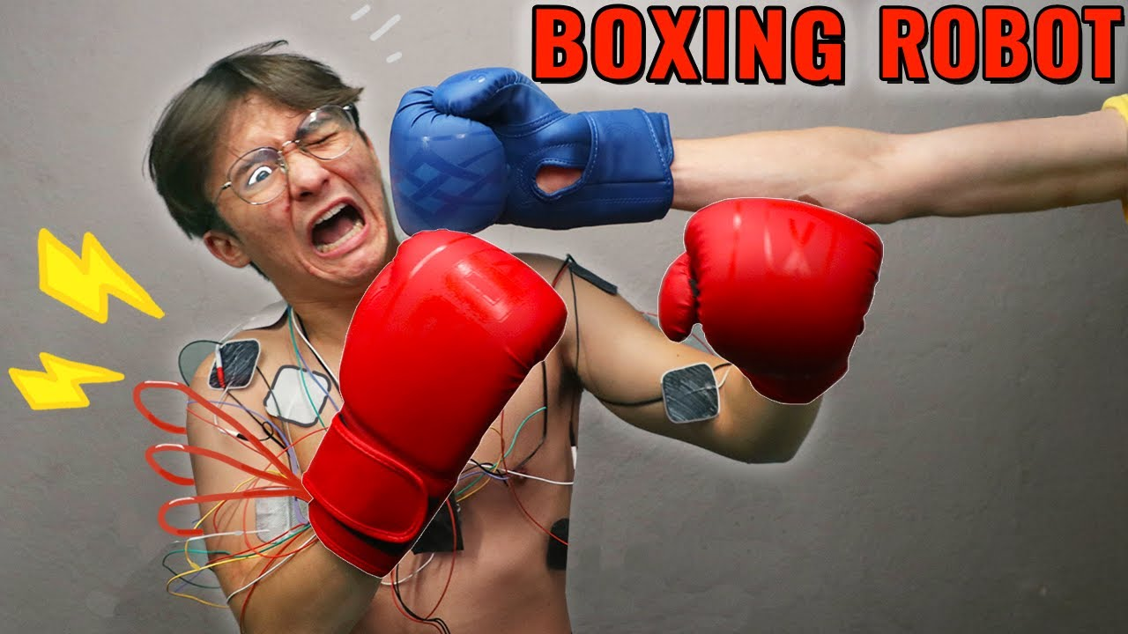
Boxing Robot
https://www.youtube.com/watch?v=fzJrH_DR6SY

Slide 15
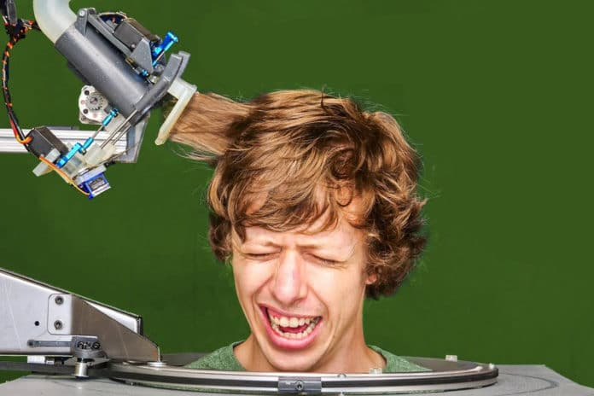
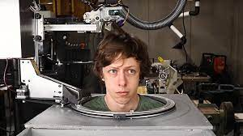
Hair cutting Robot
https://www.youtube.com/watch?v=WQ8Xgp8ALFo

Slide 16
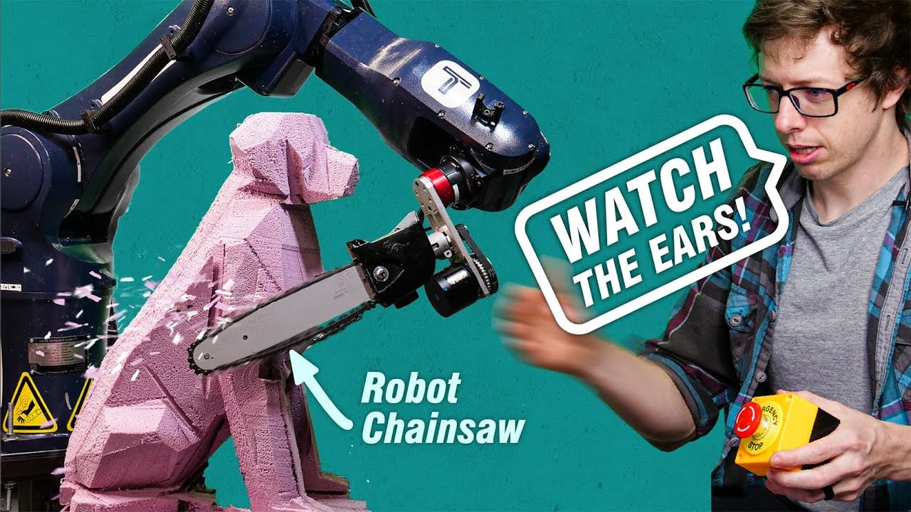
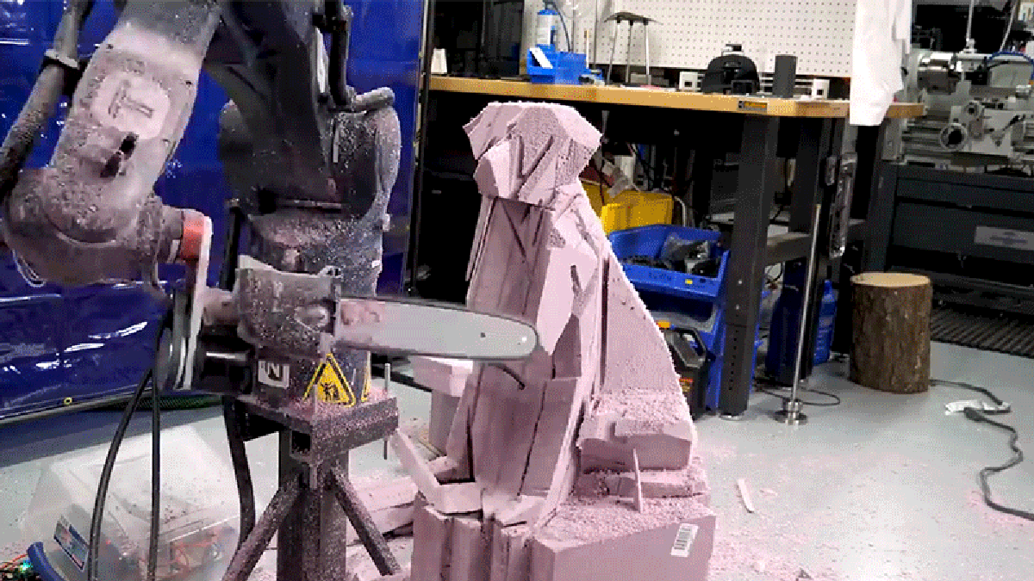
Building a Robot Arm
https://www.youtube.com/watch?v=ix68oRfI5Gw

Slide 17
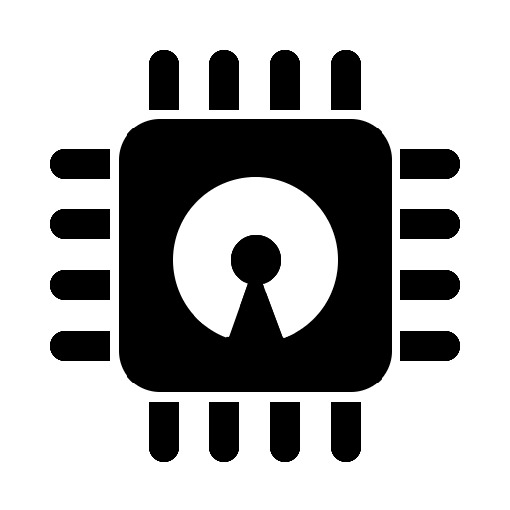

Difference between Software & Hardware

Slide 18
1. Hardware
Hardware is the physical support of a computer/embedded system.
Electronic hardware needs a PCB to be assembled.
Analog Hardware
Digital Hardware
SOC
Microcontroleur
Microprocesseur
PLA, PLD, FPGA, ASIC
Logical gate, flip-flop, counter, memory
Diode, transistor
Resistor, capacitor, inductance
Amplifier
Oscillator
Diode, transistor
Resistor, capacitor, inductance
High level
Low level

Slide 19
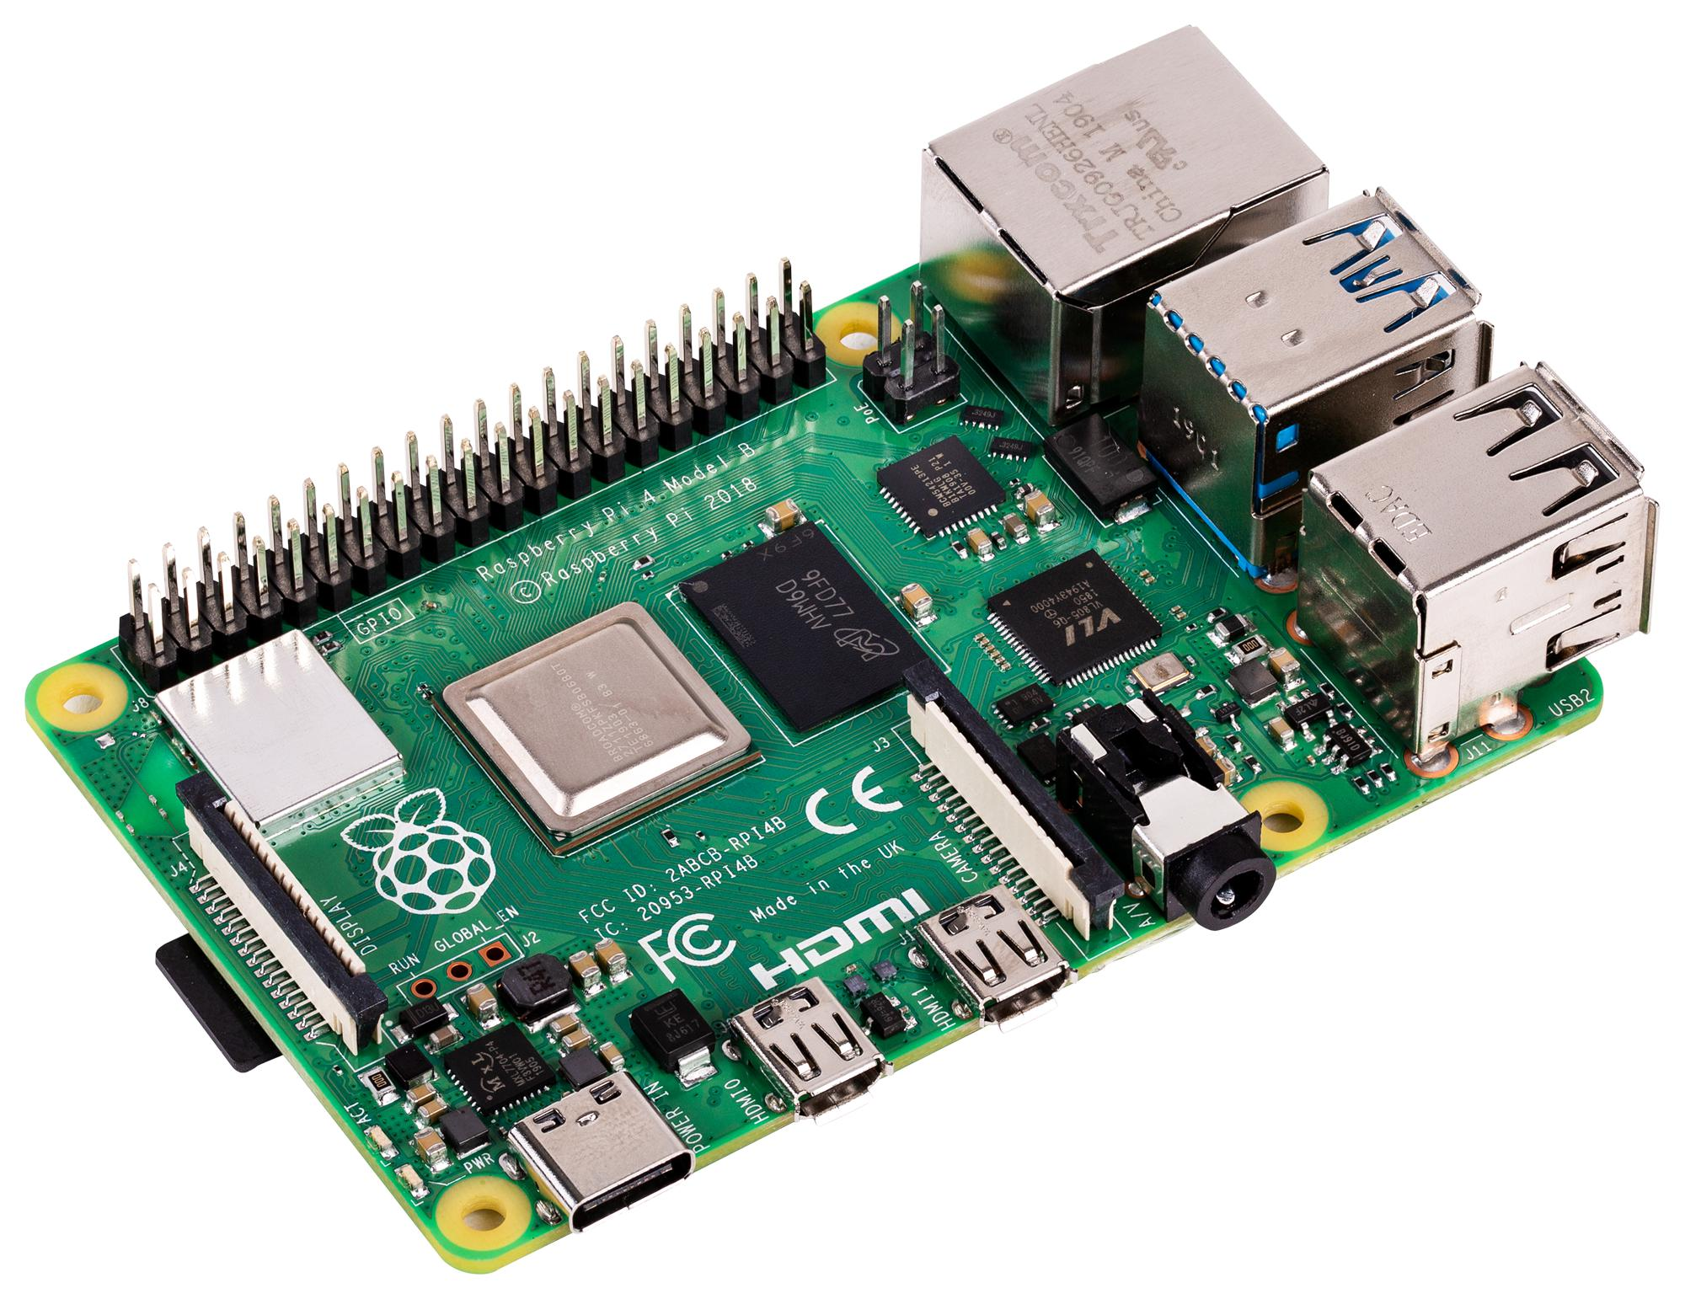
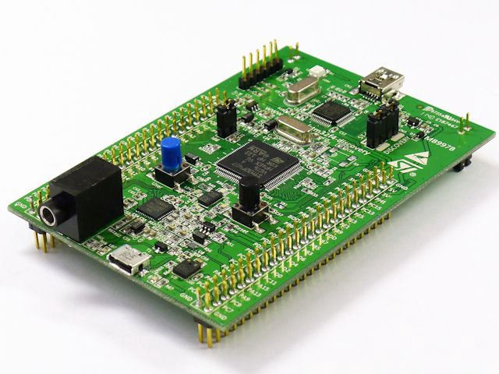
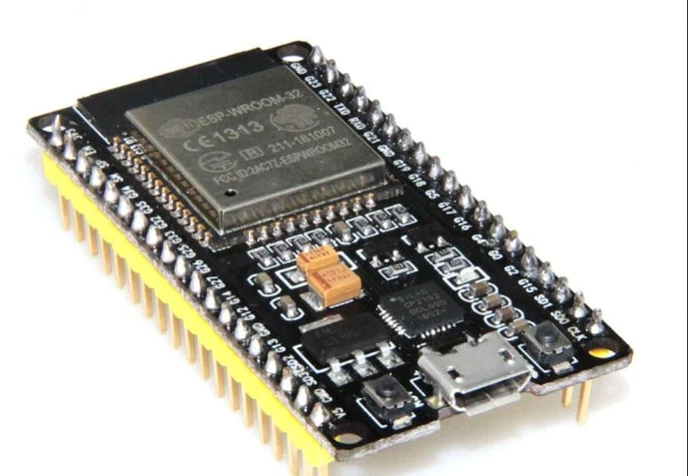
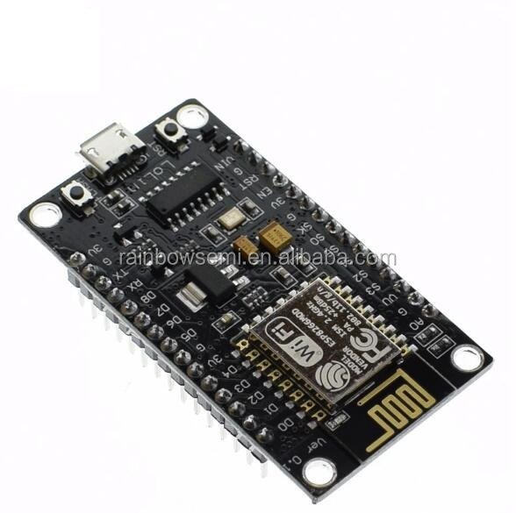
Micro-Controllers

Slide 20
2. Software
Software is the operational support included in a computer/Embedded system.
It is a set of codes that execute a specific application.
It is the part that you cannot see or touch.
Devided into 3 parts:
Applications
Tools
License

Slide 21



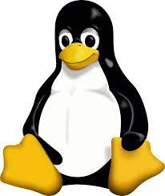


Application
Application (end-user)
Operating system
Drivers
Assembly language

Slide 22
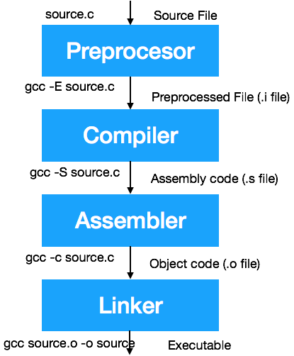
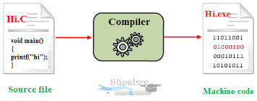
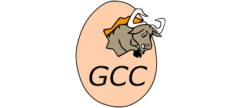
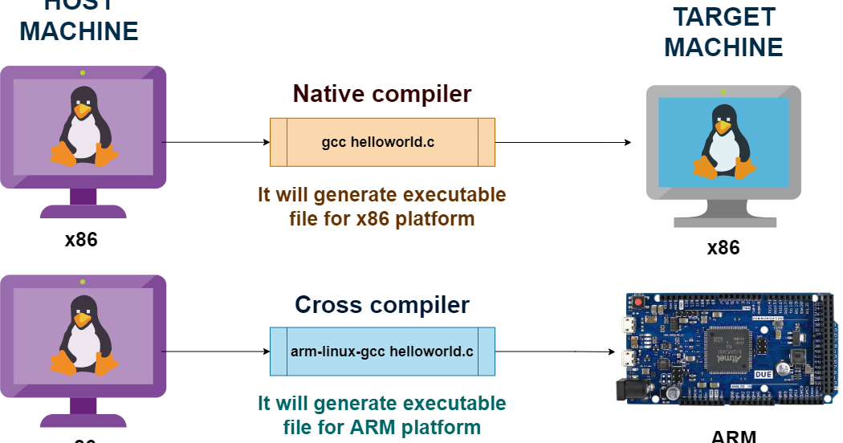
Tools
Compiler & Cross-compiler

Slide 23
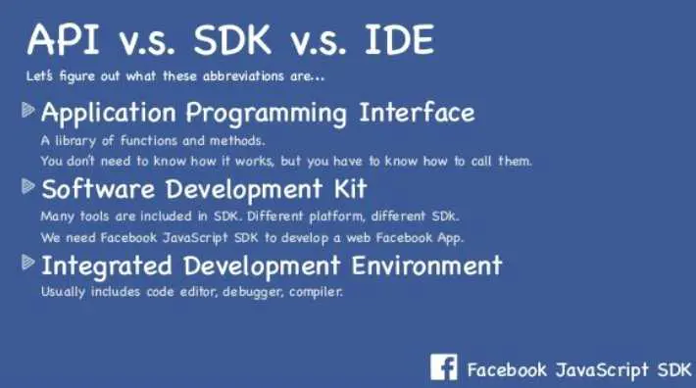
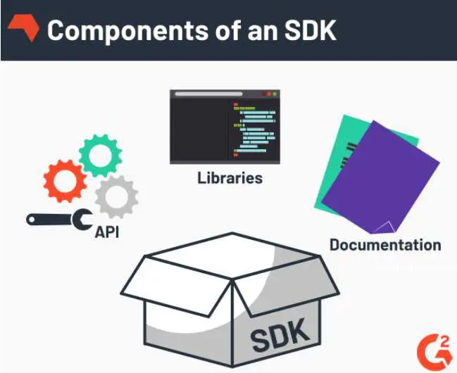
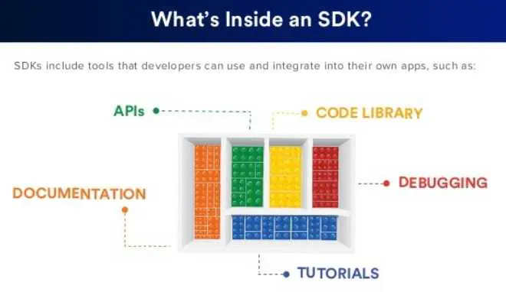
Tools
IDE vs SDK

Slide 24
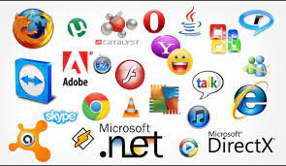





Licence
Freeware
Shareware
Open source

Slide 25
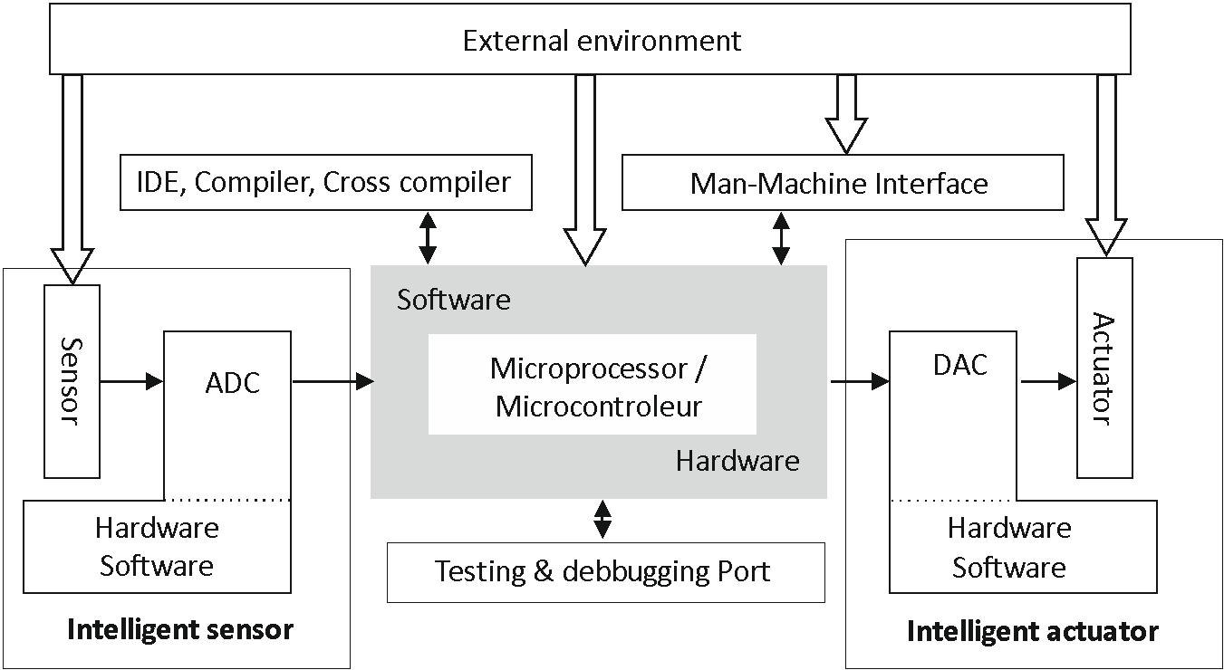
The Bridge between Hardware and Software
An embedded system is an autonomous hardware software system dedicated to a specific task.

Slide 26
Embedded systems:
Transportation
Robotics
IoT
Space
Embedded systems
Telecommunications
Drones
Environment

Slide 27
Introduction to Arduino & Arduino IDE

Slide 28

1. Introduction to Arduino
Arduino is an open-source hardware and software platform designed for computer programmers, industrial artists, professionals and those interested in developing interactive devices and applications specific to an interactive development environment.

Slide 29
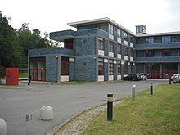
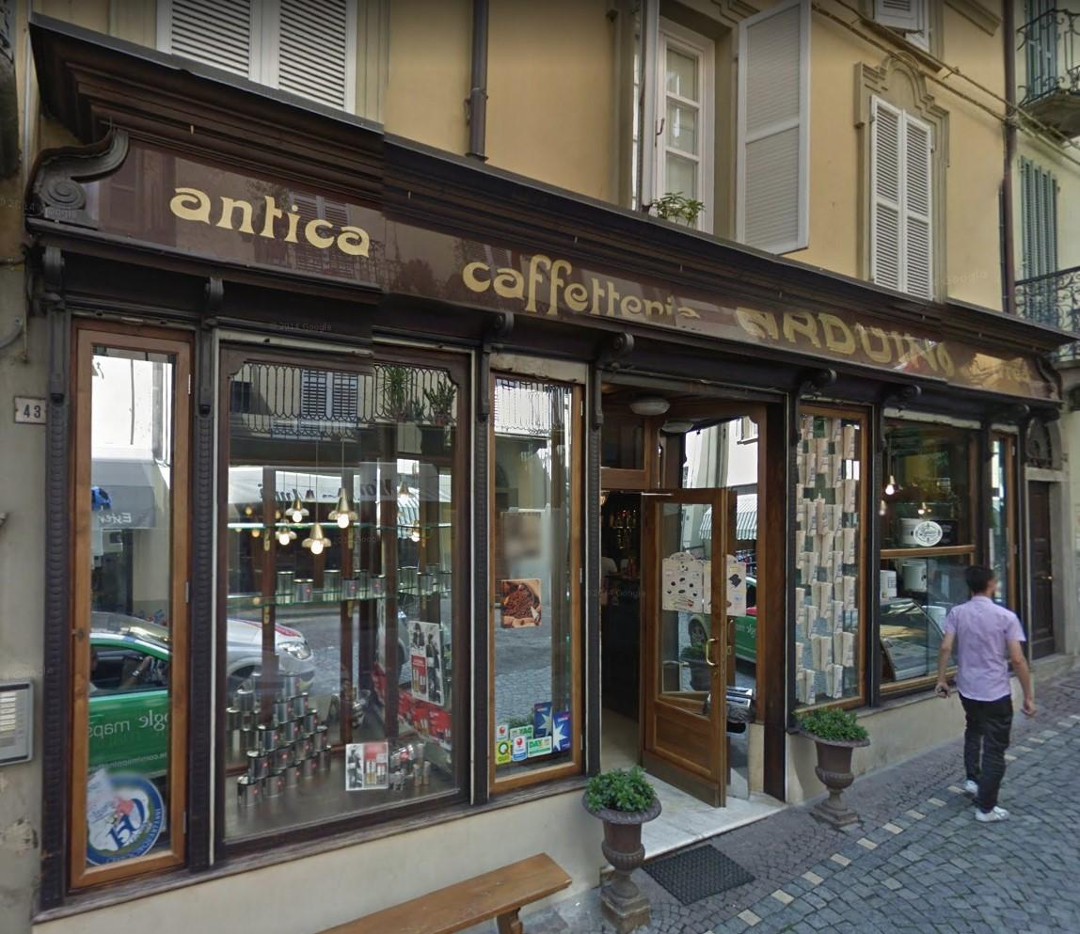
2. History
Arduino started in as a small project for students at the Interaction Design Institute Ivrea.

Slide 30
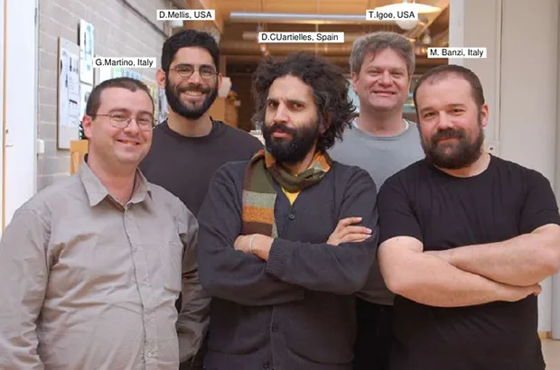
2. History
Banzi student’s couldn’t find a cheap and easy-to-use microcontroller.
In the winter of 2005, Banzi mentioned this issue while talking with David Cuartielles, a chip engineer who was a visiting scholar to Massimo’s university.
They decided to design their own circuit board.
Banzi’s student David Mellis designed a programming language for their board.
Mellis finished the source code within two days.
They named the project Arduino.
In 2008, Arduino was launched worldwide.
Massimo Banzi - David Cuartielles - David Mellis Tom Igoe - Gianluca Martino

Slide 31
3. Arduino boards
https://www.arduino.cc/en/hardware
https://www.arduino.cc/pro/hardware

Slide 32
Arduino Projects

Slide 33
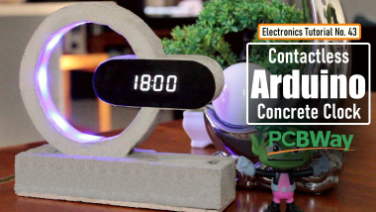
Contactless Arduino Clock
https://www.electromaker.io/project/view/arduino-based-concrete-clock-with-touchless-night-lamp

Slide 34
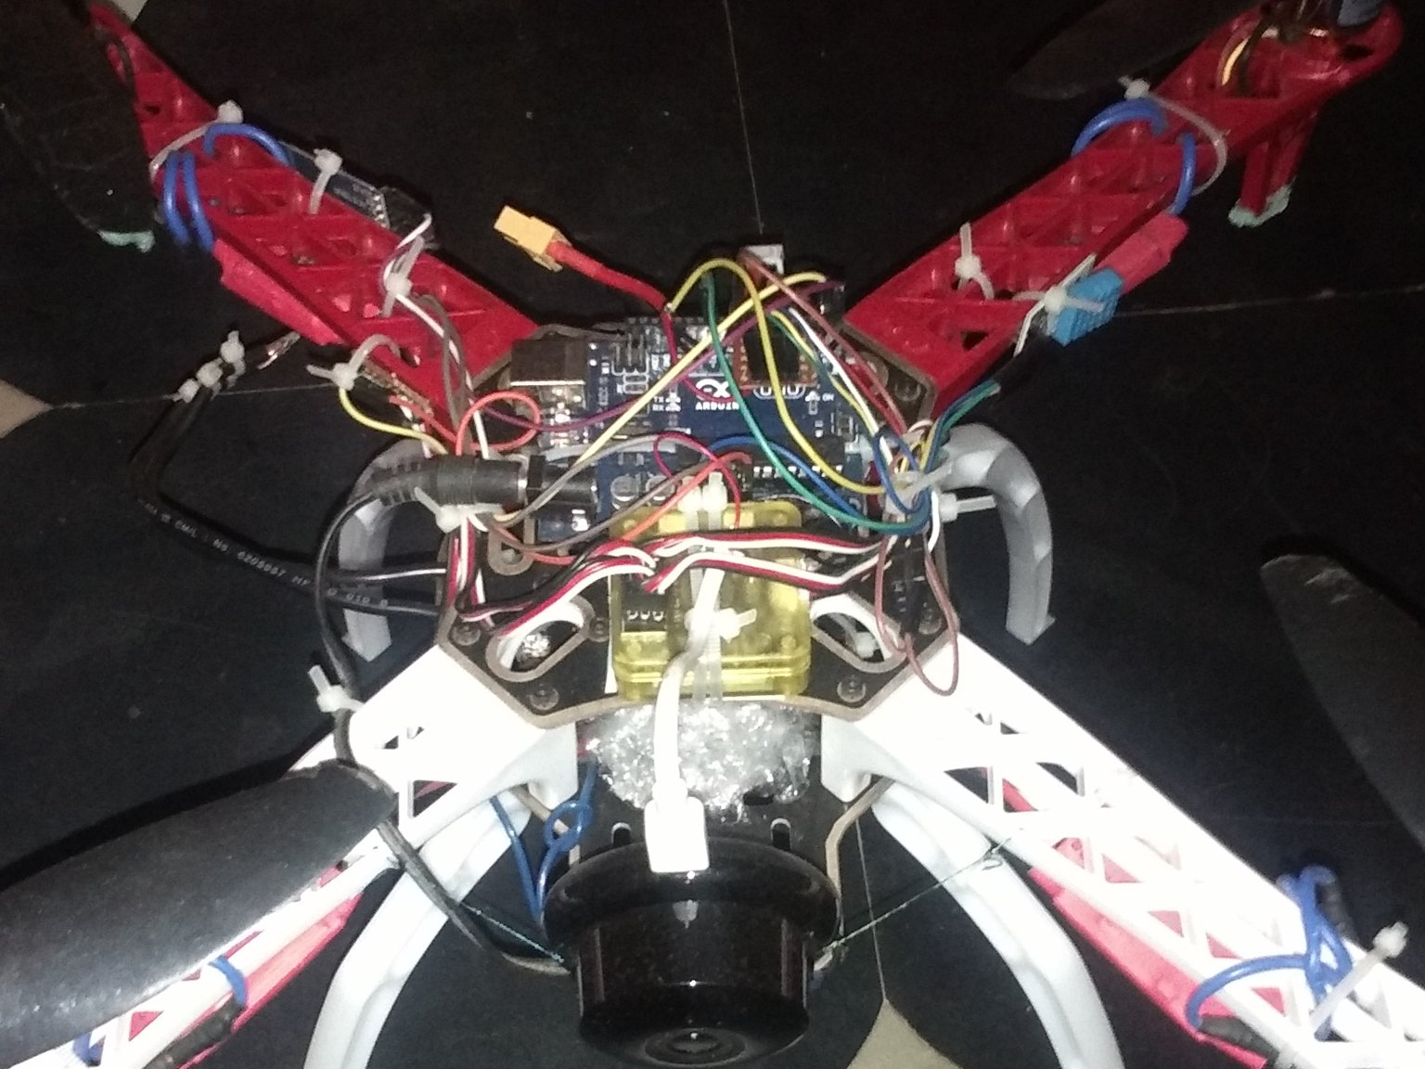
Autopilot Drone
https://projecthub.arduino.cc/suhaspn007/d3fa9f22-6495-4365-8697-8a77e8feabbd

Slide 35
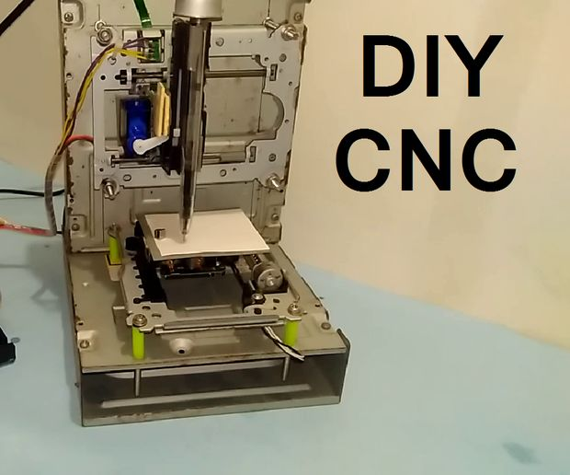
Arduino Based Mini CNC 2D Plotter
https://projecthub.arduino.cc/Mrinnovative/796c2fc9-4c25-4939-bb5b-ae973200f5fe

Slide 36
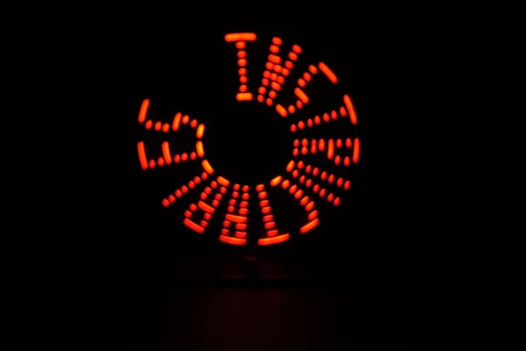
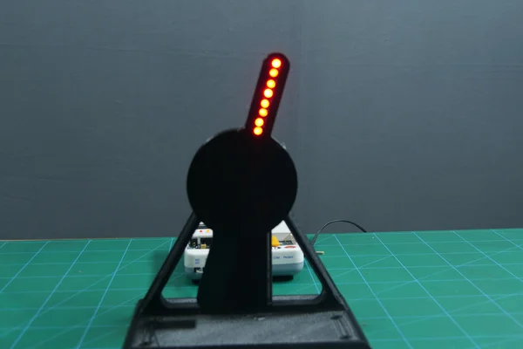
Persistence of Vision (PoV) Display
https://www.instructables.com/Persistence-of-Vision-PoV-Display-Using-Arduino/

Slide 37
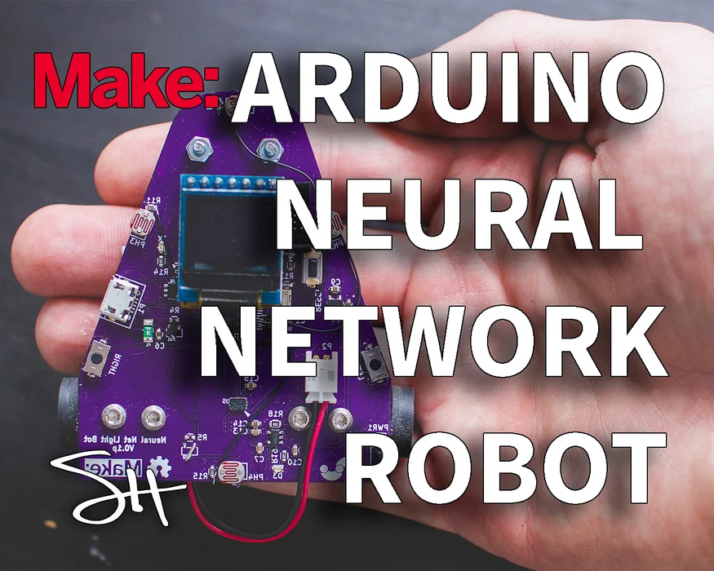
Arduino Neural Network Robot
https://www.instructables.com/Arduino-Neural-Network-Robot/

Slide 38
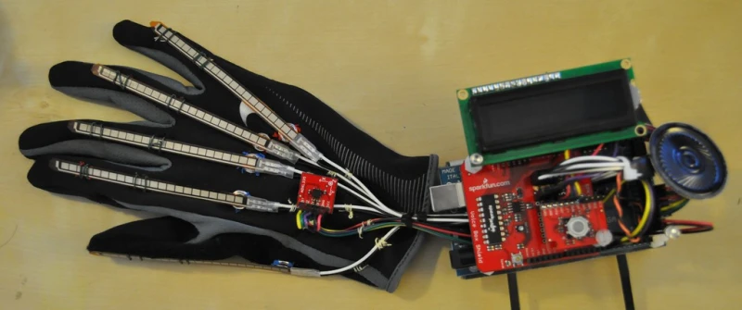
FROM SIGN LANGUAGE TO SPOKEN LANGUAGE
https://hackaday.com/2010/10/04/from-sign-language-to-spoken-language/

Slide 39
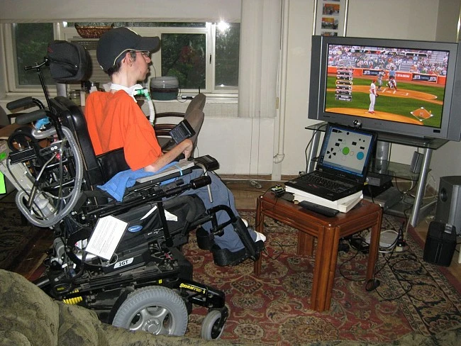
PLAYSTATION 3 CONTROLLED WITH HEAD MOVEMENT
https://hackaday.com/2013/07/05/playstation-3-contolled-with-head-movement/

Slide 40
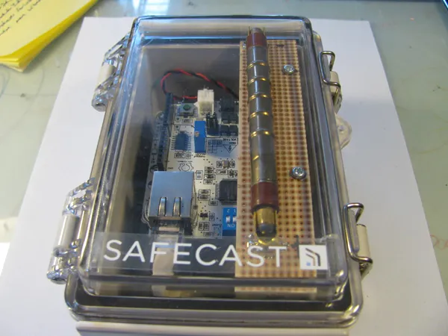
Tokyo Hackerspace/RDTN Geiger Shield
https://www.electromaker.io/project/view/arduino-based-concrete-clock-with-touchless-night-lamp

Slide 41
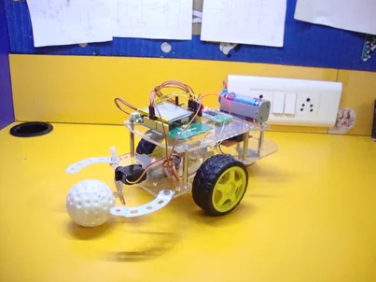
The Soccer Robot
https://www.electromaker.io/project/view/arduino-based-concrete-clock-with-touchless-night-lamp

Slide 42


Arduino Dino Game
https://github.com/Onizuka09/ArduinoDino

Slide 43
Getting started with Arduino UNO

Slide 44

4. Arduino UNO Architecture

Slide 45

5. Arduino UNO Pinouts

Slide 46
Downloading Arduino software & Building an application.

Slide 47
1. Downloading Arduino IDE
https://www.arduino.cc/en/software

Slide 48

2. A tour of Arduino IDE

Slide 49
3- The first program : Blinking an LED
Arduino built in function
Working with registers
Creating a simple library

Slide 50
4. Arduino functions
Delay()
digitalWrite()
digitalRead()
analogWrite()
AnalogRead()
Serial.print()
Serial.Read()

Slide 51

4.1 digitalWrite() vs digitalRead()

Slide 52

4.2 analogWrite()

Slide 53

4.3 analogRead()

Slide 54

4.4 Serial communications:

Slide 55
5. Building Arduino Applications
Weather monitoring
Distance measurement

Slide 56



Weather monitoring
-Arduino UNO
-DHT22 sensor
-Jumper wires

Slide 57

Distance measurement
-Arduino UNO
-Ultrasonic sensor
-Jumper wires

Slide 58

Replicating a robot

Slide 59

Controlling a Robot Car via a Joystick controller (Radio Frequency Module)

Slide 60

NRF24L01+ Module:
The nRF24L01+ transceiver module transmits and receives data on a certain frequency called Channel. Also in order for two or more transceiver modules to communicate with each other, they need to be on the same channel.
This channel could be any frequency in the 2.4 GHz ISM band or to be more precise, it could be between 2.400 to 2.525 GHz (2400 to 2525 MHz).
Each channel occupies a bandwidth of less than 1MHz. This gives us 125 possible channels with 1MHz spacing. So, the module can use 125 different channels which give a possibility to have a network of 125 independently working modems in one place.

Slide 61


Controller (transmitter)
Arduino UNO
NRF24 radio frequency module
Jumper wires
Joystick

Slide 62

Robot Car (receiver)
Arduino UNO
H-bridge LN298
NRF24 radio frequency module
Jumper wires
2 Motors

Slide 63
Reference Sheet:
Reference NRF24L01 Module:
https://acoptex.com/project/9451/basics-project-083a-nrf24l01-24ghz-rf-transceiver-module-at-acoptexcom/
Reference :
https://www.youtube.com/watch?v=lhGXAJj8rJw

Slide 64
Thank You for your attention

